Slide 1

Integrating Project
PROJECT
PRCO203, PRCS251, PRDC251
DATE
January 2017
Client
Dr Shirley Atkinson

Slide 2

Session Overview
Introduce Module
Agile

Slide 3
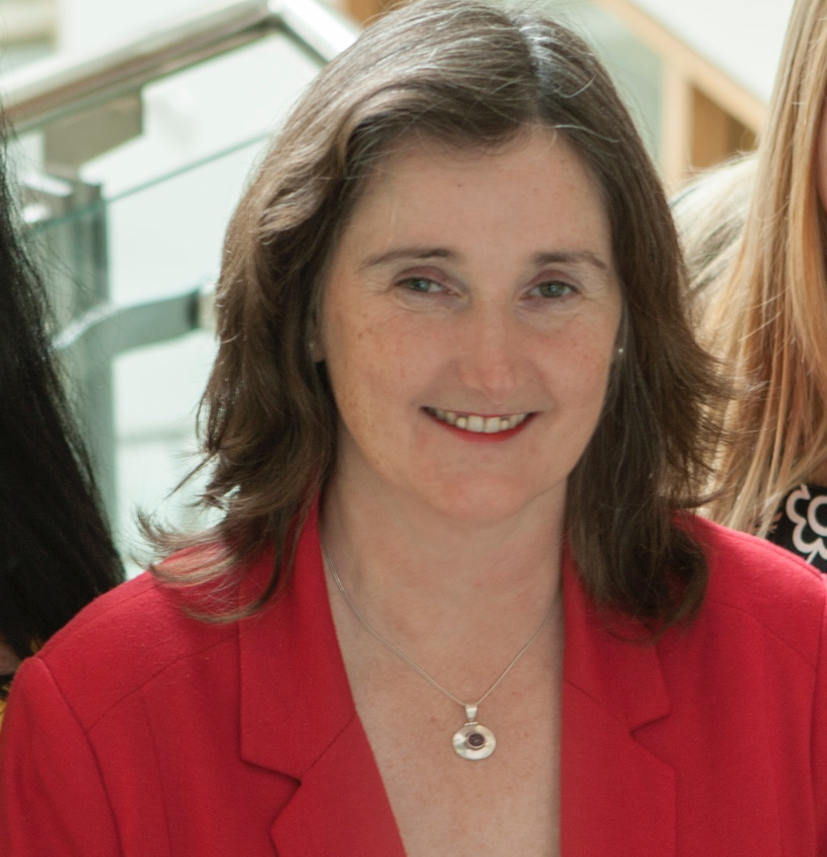

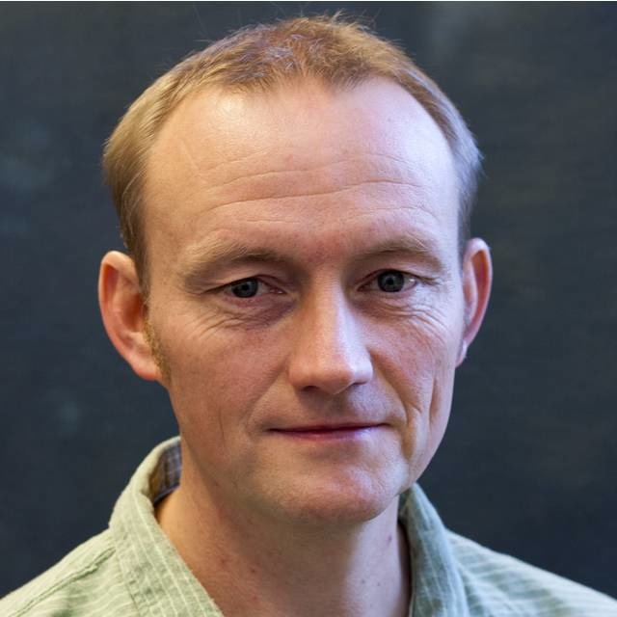
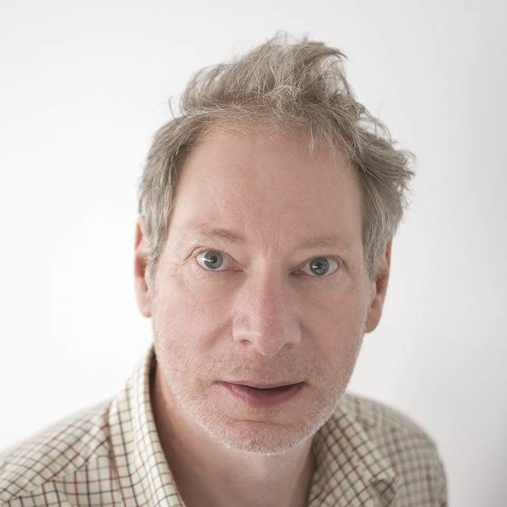
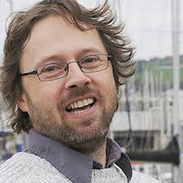
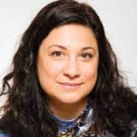
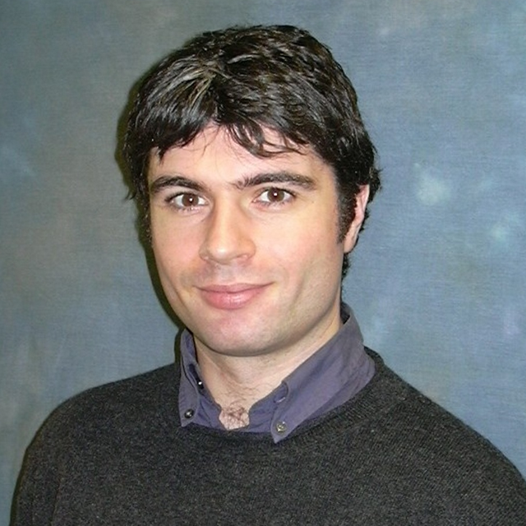
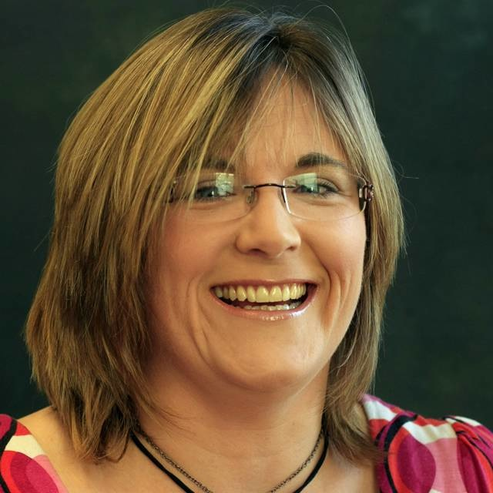
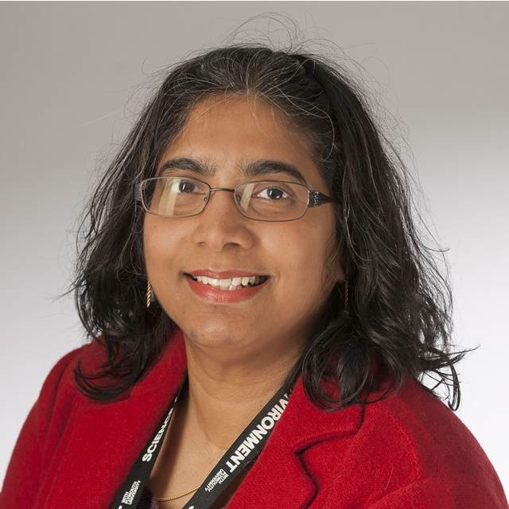
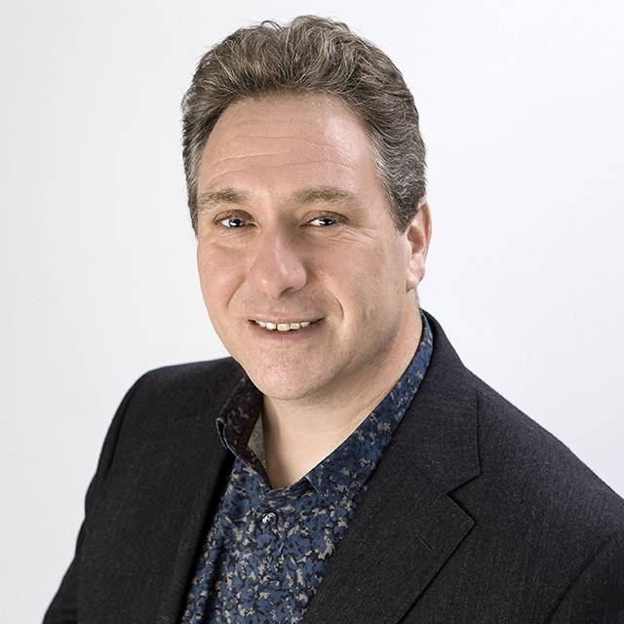
Module Leader
HCI
SE
SE (Android)
SE (iOS)
Dr Shirley Atkinson
Dr Mark Dixon
Dr Torbjorn Dahl
Dr Nigel Barlow
Dr Nick Outram
DB
HCI
HCI
RE
Games
Dr Ismini Vasileiou
Mr John Forde
Dr Liz Stuart
Ms Pushpa
Subramaniam
Dr Dan
Livingstone

Slide 4


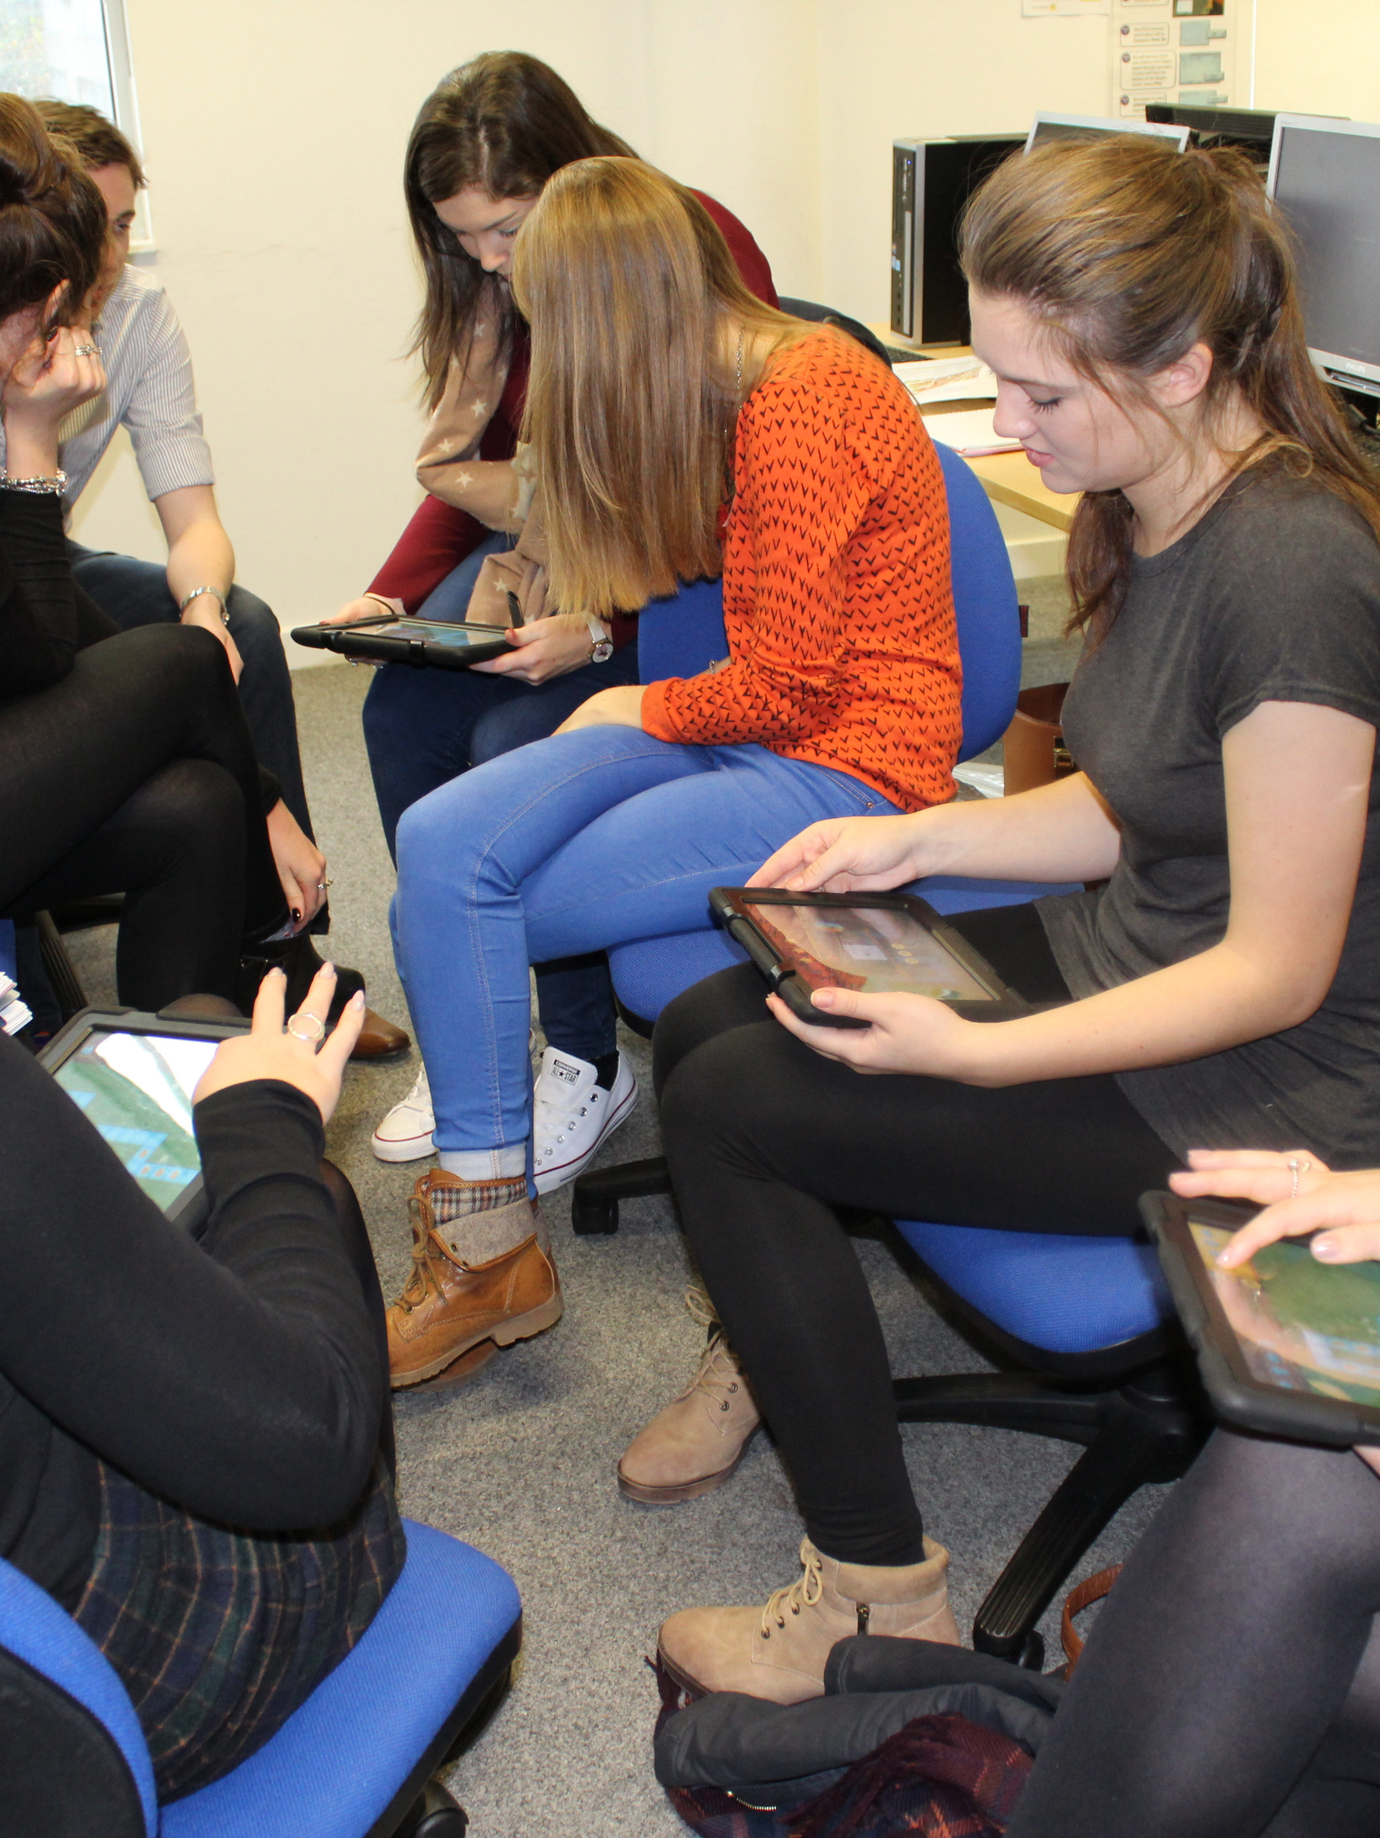
Module Aims
Software Engineering
Project Management
to enable students to integrate many of the disciplines studied, through participating in a major group software engineering project
HCI
Requirements Analysis
Networking
Databases

Slide 5
Learning Outcomes
Specific wording differs between the modules, but overall ..
You need to prove…..
Can work as a member of a team in order to manage a project throughout the whole system lifecycle - analysis, design and implementation.
Can analyse an identified problem domain.
Can design and implement a software system to solve a given problem.
Each degree programme proves this in slightly different ways

Slide 6
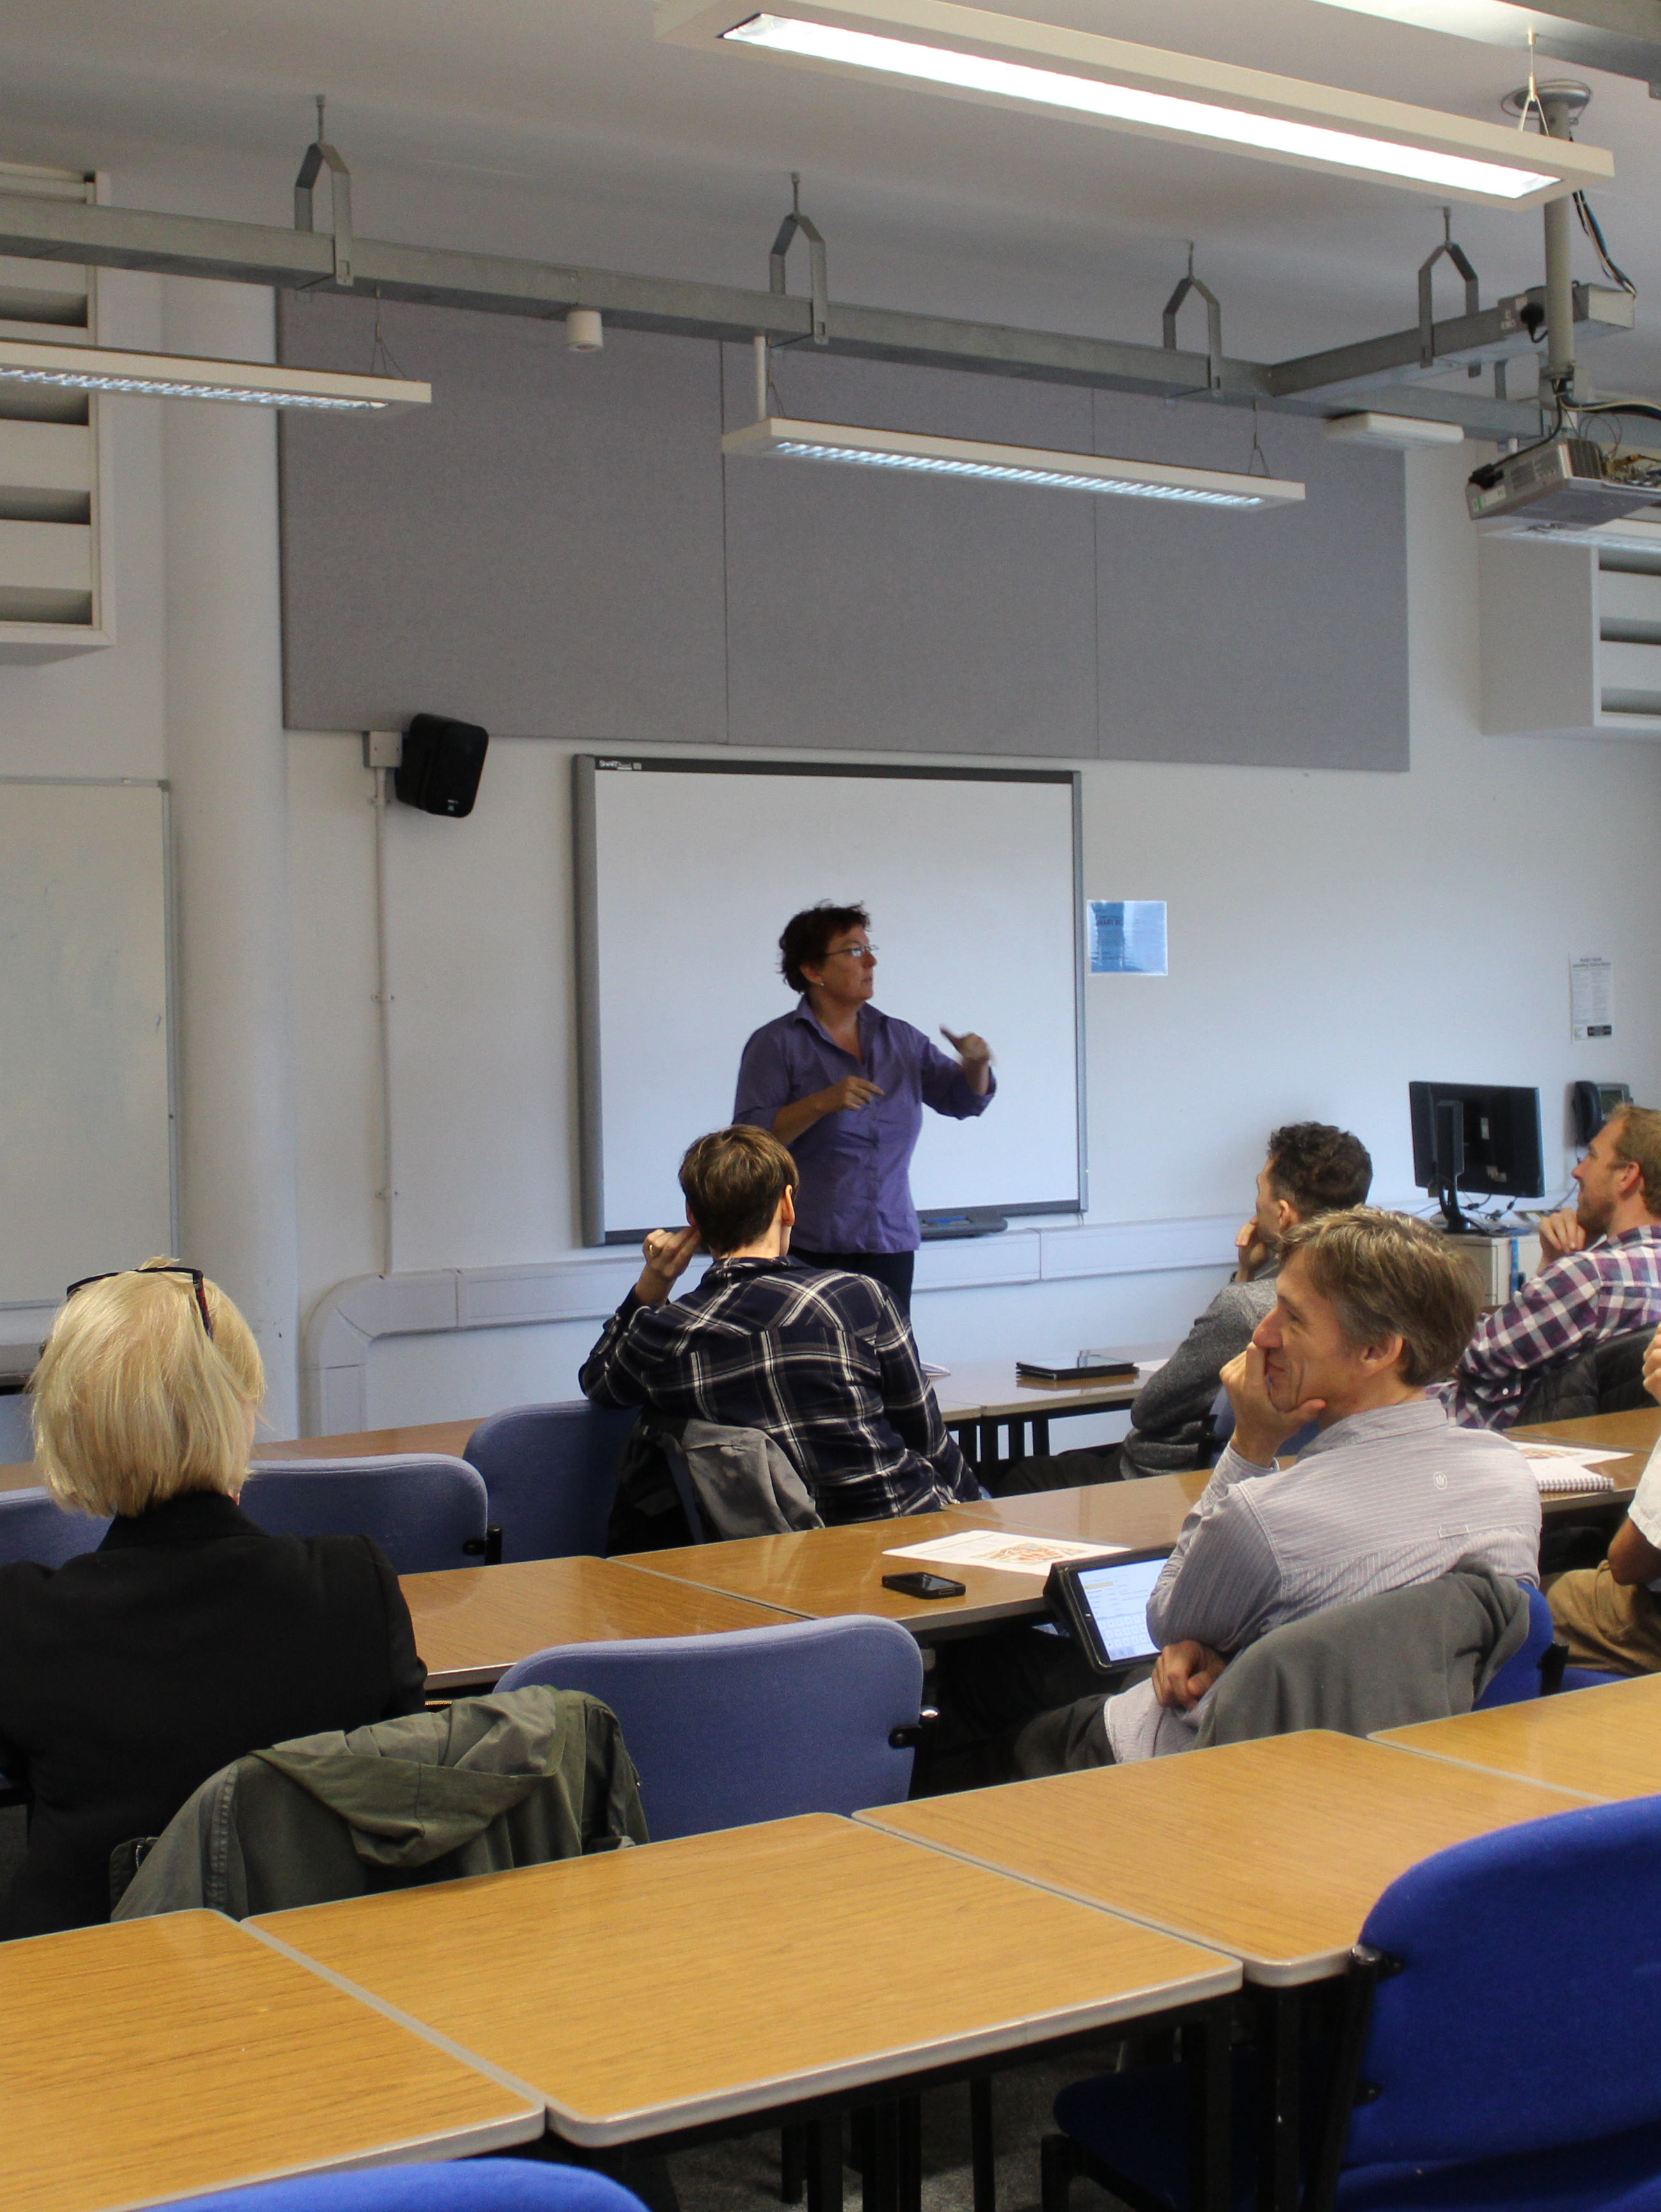
Contact arrangements
Initial lectures on specific topics to get you started
Agile
HCI
Requirements Analysis
Usability
Version control
Meetings with module staff every two weeks
Assessment points to provide feedback and ensure you are on track
Cognitive walkthrough, Usability studies
Subject specific help from staff by email

Slide 7
Deliverables
PRCO203 (CGD)
Clients will determine exact nature of software
Agile artefacts, project plans, minutes of meetings, design materials, software product, demonstration and report.
PRDC251 (Comp)
Clients will determine exact nature of software
Agile artefacts, project plans, minutes of meetings, design materials, software product, demonstration and report.
PRCS251 (Comp Sci)
Mobile app, desktop application, middleware to connect both to datastore
Requirements analysis, design materials, software products, demonstration and report.

Slide 8

PRCO203 (CGD)
Meet clients in seminar set by Dan
Professional approach required
Use agile methodology to develop user stories
Marked on process of handling live client
Peer assessment used

Slide 9

PRDC251 (Comp)
Client meeting on 2nd February
Client documentation already online
Bids by end 2nd
Peer assessment used

Slide 10

PRCS251 (Comp Sci)
Scenario issued at start of module
Liaise with John Forde to ensure understanding of requirements
App development taught alongside SOFT254
Android OR IOS
HEALTH WARNING! IOS only for self-motivated individuals
Peer assessment used

Slide 11
Timetable
Your responsibility to check it weekly/daily
Sync with your phone
Not our responsibility to tell you where to go and where to be
Do NOT assume there is just a regular pattern
Look at timetable NOW

Slide 12
Events & Deadlines
Will be clearly published on the DLE
Will comprise the following:
Cognitive walkthrough
Usability study
Architecture demos
Interim deliverables
Final group report
Final group presentations
Peer reviews

Slide 13
Group Organisation
Roles needed:
Planning and management (using Trello, Kanban Flow or Pivotal tracker). Ensure proper use of user stories to breakdown features/functionality into task lists with named owner/implementer.
Implementation and version control. GIT. Use branching/forking weekly sprints and iterative development with detailed comments for every commit.
Client handling. Pitching, reporting, ongoing documentation and communication (including scheduled client meetings with team)
Roles are not positions - any given person takes on one or more roles and can switch roles over time

Slide 14

Questions?
Or clear as mud?

Slide 15
Agile
Industry experts here
Chris Blunt from Plymouth Software
Ian Aimes from Land Registry
Mike Westwood from Babock Marine
Outline how they use Agile
How to do it!
Further resources will be online later based on discussions now

